Slide 1
FTC 5 – Command Based Programming
This will teach you to program like FRC
Ben Schwarz

Slide 2
What is Command based programming?
Command based programming is a design pattern to help you organize your robot programs. Some characteristics of robot programs that might be different from other desktop programs are:
Activities happen over time, for example a sequence of steps to shoot a Frisbee or raise an elevator and place a tube on a goal.
These activities occur concurrently, that is it might be desirable for an elevator, wrist and gripper to all be moving into a pickup position at the same time to increase robot performance.
It is desirable to test the robot mechanisms and activities each individually to help debug your robot.
Often the program needs to be augmented with additional autonomous programs at the last minute, perhaps at competitions, so easily extendable code is important.
Command based programming supports all these goals easily to make the robot much simpler than using less structured techniques.

Slide 3
FTC is a simpler world
We have ported the FRC Library Arachne to FTC and named it Spiderling.
However due to the simpler nature of FTC it is a bit different.
Chiefly: no commands, no subsystems, no OI class, and actions are nestable.
Those things will be explained in an FRC class, but for now we will look at Spiderling in FTC

Slide 4
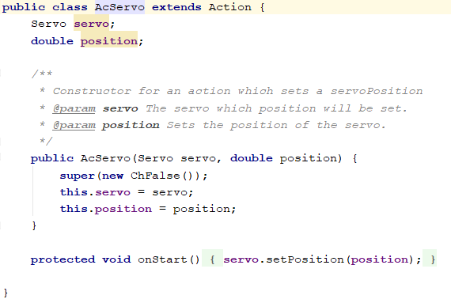
The Action
Actions are the simple units that make up robot activity.
Each Action should handle one thing. E.g. Moving the robot forward, raising the elevator.
They have methods:
onStart() – Called once when action begins
onRun() – Called repeatedly during procession of action.
OnFinish() – Called once at the end of the action.

Slide 5
The Check
The Check determines when the action should finish.

Slide 6
Hardware Wrapper Classes:
Spiderling Comes with helpful HardwareWrapper Classes.
Any default Spiderling actions or checks requires the usage of these wrapper classes to work.
They can be found in spiderling.Hardware

Slide 7
Hardware Map
The Hardware Map functions a bit differently. In this you extend HardwareMapBase.

Slide 8
With all of these – it is possible to make your own.
You are encourage to pull apart this code. Pull it apart and learn how it works.
You will need to write your own actions, and most likely your own checks when using spiderling.
If you have any doubts, a senior programmer can probably help you as this system is designed to work as similarly as possible to FRC.
However I will be more than happy to help you if you have any questions on this.
Using this system will be invaluable training for FRC.

Slide 9
Exercise: Make an auto which spins a motor for 5 seconds
I will do it on the board, but you will need to help me.

Slide 10
Exercise – Write a custom action which moves the drive base motors all at a given speed.
I will do it on the board, but you will need to help me.

Slide 11
This is a work in progress.
This library is an attempt to help you for the build season to make you better equipped to contribute meaningfully.
However, this library is new, and far more testing needs to take place, and features still need to be added.
If you find a bug or have a feature request – let me know and I will fix the bug ASAP, and get around to adding the feature.
Also, whenever a new version of Spiderling is released, I will place a message in the programming channel (make sure to check regularly for those).
The repository can be found here: https://github.com/B-e-n-S/Spiderling

